Slide 1


NeedASafe.space

Slide 2
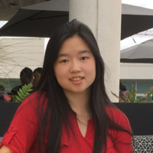
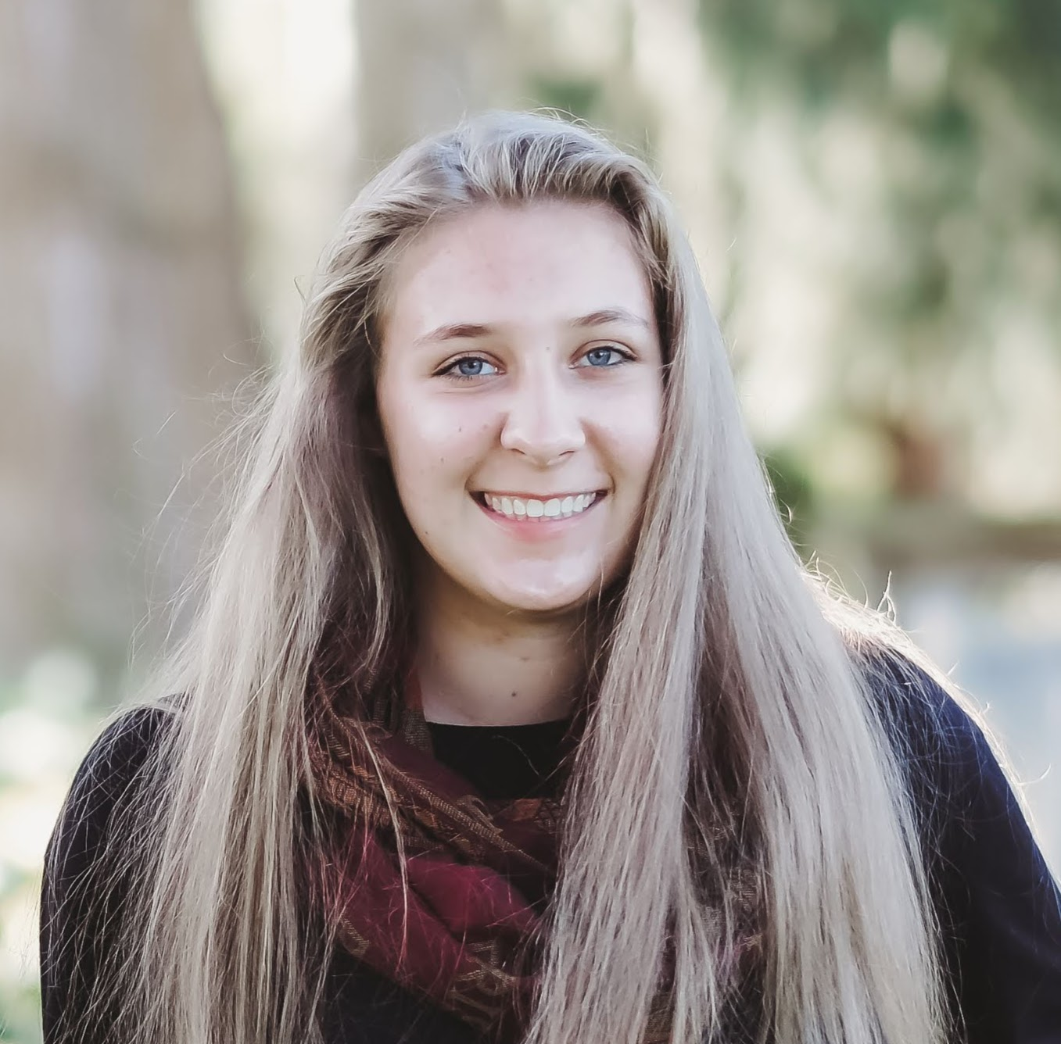
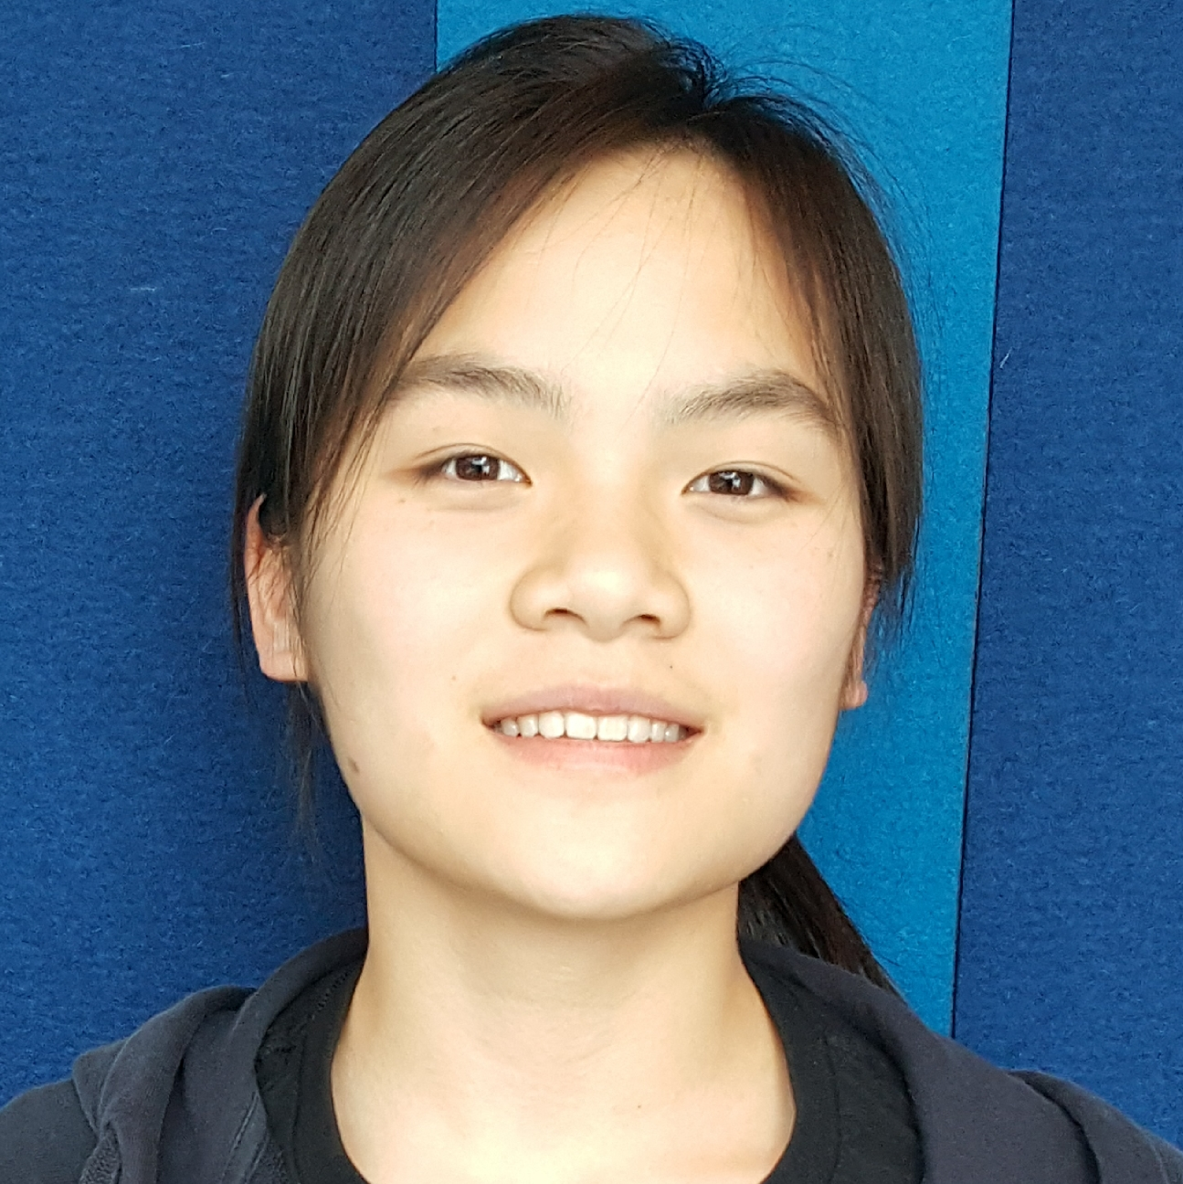
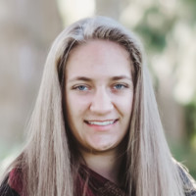
Our Team
Evelyn Chew
Business, UW
Locksley Kolakowski
Informatics, UW
Julie Chen
Computer Engineering, UW
Lynzley Kolakowski
Informatics, UW
NeedASafe.space

Slide 3
Our Mission
If you are temporarily displaced, you deserve a roof over your head.
NeedASafe.space

Slide 4
Who We Serve
People who need temporary shelter from a natural disaster
People who are escaping abusive situations
People who experience sudden and unexpected homelessness
NeedASafe.space

Slide 5
How We Work
Patrons post their shelter/housing on our service
After passing a safety check, people can utilize the shelter/housing at no cost for up to 5 days
In addition to shelter, they will have access to resources to determine a permanent solution
NeedASafe.space

